Slide 1


[Title]

Slide 2


Today's agenda
Project recap
Problem
The Analytics team
Process
Insights
Summary

Slide 3

Social Buzz is a social media marketing company that helps businesses grow their online presence.
They are looking for help to improve their understanding of their customers and how they are using social media.
They want to use data analytics to identify trends and patterns in customer behavior, so that they can target their marketing campaigns more effectively.
Project Recap

Slide 4


How can data analytics be used to improve Social Buzz's understanding of their customers and how they are using social media?
What trends and patterns can be identified in customer behavior?
How can these trends and patterns be used to target marketing campaigns more effectively?
Problem

Slide 5



Andrew Fleming (Chief Technical Architect)
The Analytics team
Marcus Rompton (Senior Principle)
Usman Derek Yahaya (Data Analyst)

Slide 6
Process
1
Project Understanding
2
Research Question
3
Data Understanding
4
Data Cleaning
5
Data Transformation

Slide 7

Insights

Slide 8
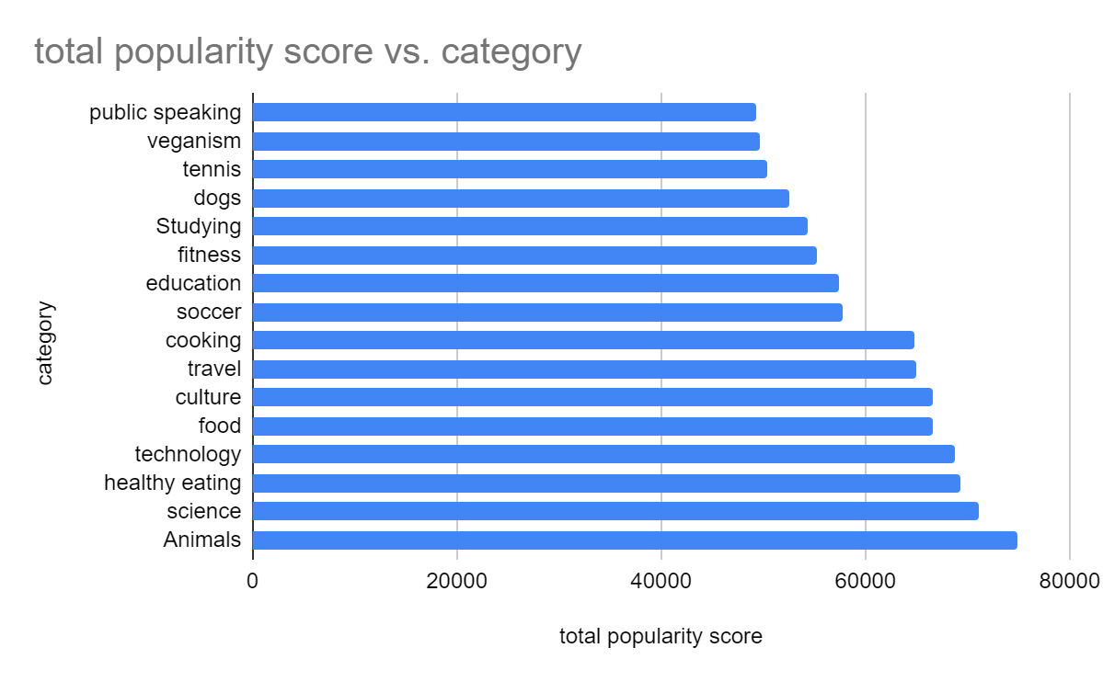
The insights from the analysis above as it relate to the overall objective shows that animals tend to accumulate the highest, numbers of popularity score, raking up to 74965 scores.

Slide 9
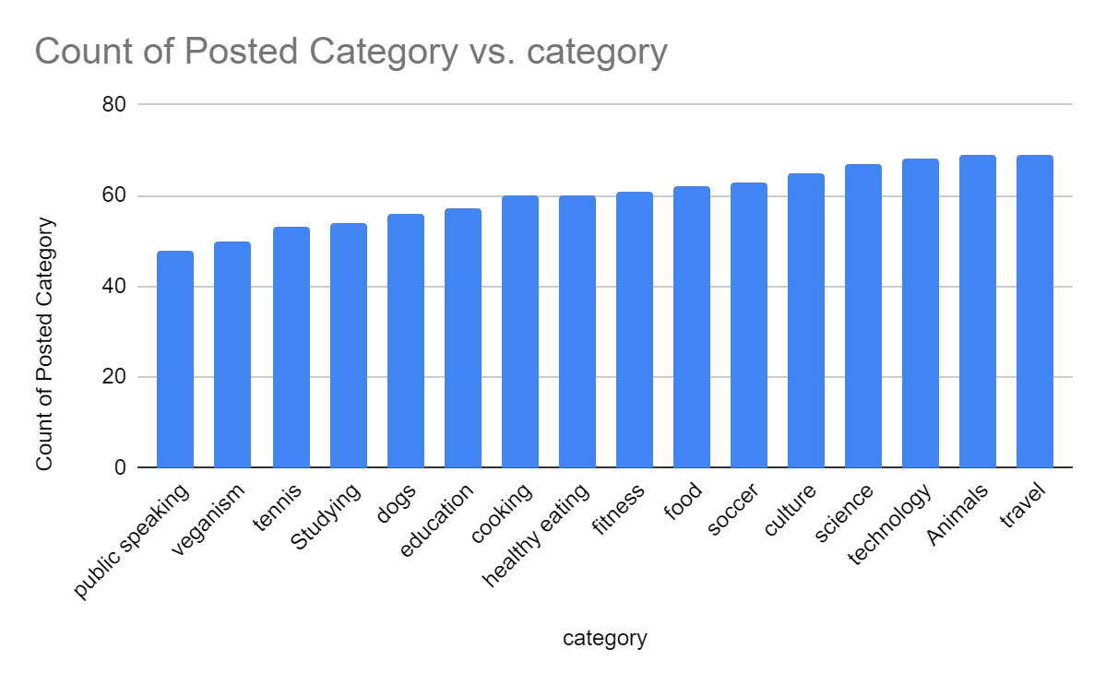
Further analysis shows that travel related contents have been more observed within the timeframe, accounting for more than 69.

Slide 10
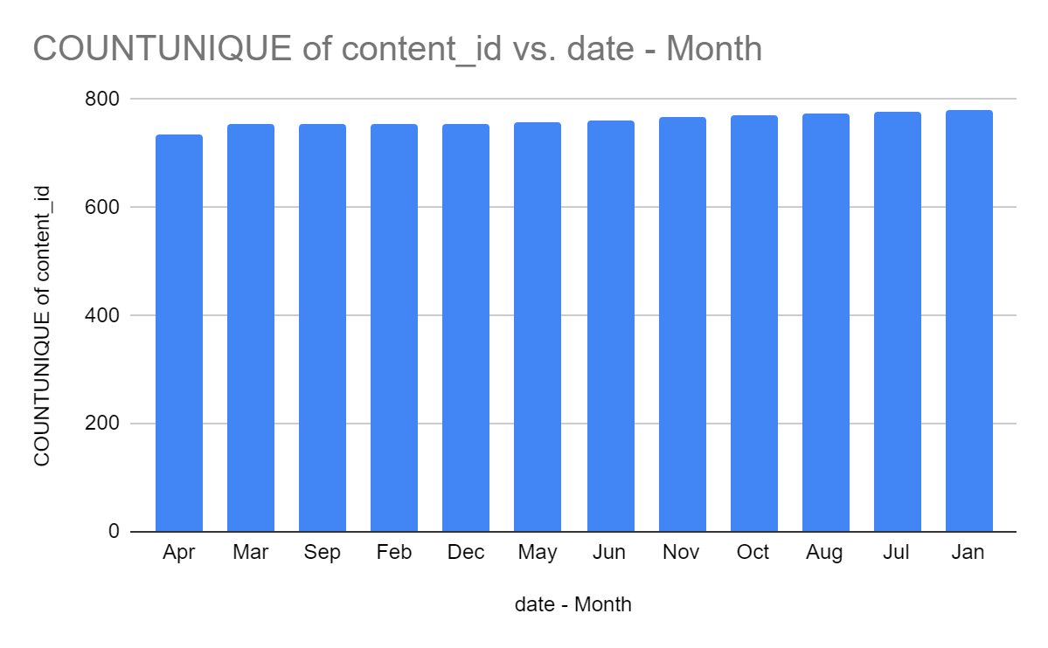
It is also noted that january accounts for the most active months with more contents posted on the month followed by july and april accounting for the least amount of contents posted.

Slide 11

Animals are the most popular content type on Social Buzz's social media channels, with a mean popularity score of 74,965.
Travel is another popular content type, with 69% of Social Buzz's social media posts being about travel.
The popularity of animal and travel content suggests that Social Buzz's target audience is interested in these topics.
Social Buzz could use the insights from this analysis to create more engaging and popular content, such as by creating more animal-related content or focusing on travel content that is relevant to their target audience.
Summary

Slide 12

Thank you!
ANY QUESTIONS?

